Slide 1
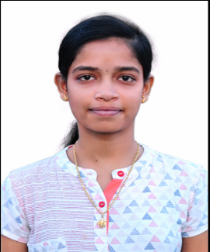
Vysyaraju Jyothsna
Software Engineer
PROFESSIONAL ACHIEVEMENTS
SUMMARY
To work in a challenging environment where I can bring out the best of my abilities.
Completed a summer internship at “Fluent Grid Limited” located at Visakhapatnam. Done a project “Power Utility-New Service Connection Module”.
Certified in BECS exam (Aptis) with B1 grade, Test Package-Speaking in 2018.
Published a Survey paper on “Mouse Cursor Control System Based on Hand Gesture”.
TECHNOLOGY SKILLS
Languages : C, Java.
Front End : HTML, CSS, jsp.
Tools: Spring, Hibernate, Jenkins, Sonarqube, Nexus, Git, Ansible.
Trained: Core JAVA, DevOps.
CAREER ACHIEVEMENTS
Participated in “Artificial Intelligence and Machine Learning” workshop in 2018 at UVEC-JNTUK of UTKRAANTI-18 in asso. With NSSC-IIT Kharagpur organized by Wingfotech Pvt. Ltd.
Participated in 3“Android App Development” workshop in AITAM college in 2018.
Participated in “Virtual Lab” workshop in AITAM college in 2018.
Participated in quiz competition in AITAM College on the occasion of “49th and 50th Engineers day conducted by CSI.
RELEVANT WORK EXPERIENCE
PERSONAL SKILLS
•Used Jenkins as an integration tool and added multiple tools as part of the pipeline.
•Worked on other tools like sonarqube, git, nexus, maven integrated with Jenkins.
•Used AWS to create instance and used it to implement Jenkins pipeline.
•Have hands-on experience in Linux and power shell commands.
•Worked on Ansible, terraform and azure DevOps.
Time Management.
Communication.
Team Work.
EDUCATION
Bachelor of technology in Computer science and engineering

